Slide 1
Project Title- Customer Retention
Presentation

Slide 2
Problem Statement & Understanding:
Problem Statement
A new project is allocated and the project name is Customer Retention.
The attached zipped folder contains the below files:
Customer_retention_case_study
Customer_retention_dataset
Submission file needed to contain the below three files:
The jupyter notebook solution
The project report in pdf format
A PowerPoint presentation containing problem statement and understanding, EDA steps and visualizations, Steps and assumptions used to complete the project, analysis, and conclusion.

Slide 3
Understanding
We are provided with a dataset which contains more than 47 columns of factors that directly affects an online shopping store. It contains the data of a survey taken from different age group peoples from different areas of India. It shows what website they prefer more to shop and recommend to other peoples as well.
Customer satisfaction has emerged as one of the most important factors that guarantee the success of online store; it has been posited as a key stimulant of purchase, repurchase intentions and customer loyalty. A comprehensive review of the literature, theories and models have been carried out to propose the models for customer activation and customer retention. Five major factors that contributed to the success of an e-commerce store have been identified as: service quality, system quality, information quality, trust and net benefit. The research furthermore investigated the factors that influence the online customers repeat purchase intention. The combination of both utilitarian value and hedonistic values are needed to affect the repeat purchase intention (loyalty) positively. The data is collected from the Indian online shoppers. Results indicate the e-retail success factors, which are very much critical for customer satisfaction.

Slide 4

EDA Steps

Slide 5
1. Checking the attributes: A. Shape of the dataset B. Columns present in the dataset C. Datatypes of each column in the dataset Pre-processing the columns name like removing the number and extra space from it A. Unique values in each column B. Checking the null values in the dataset 2. Univariate analysis A. Analysed the personal details like age, city, gender, how many time they shop in the past year, since how long they are shopping.

Slide 6
3. Bivariate Analysis:
Intention of repeat purchase
Online retailing
Information
System quality
Satisfaction
Net benefits
Brand image
Loyalty

Slide 7

Visualizations

Slide 8
Below are the visualizations in my project to analyse the data in different ways:
Pie chart
Strip plot
Count plot
Line plot
Violin plot

Slide 9
Let’s see the analysis
1. Personal Info - It contains the personal details of a person like age, city, gender, how many times they shop in the past year, since how long they are shopping. We use the pie plot to see the different percent in the dataset and determine which category has the superiority. We found these conclusions after plotting:
There is double the number of women than men who have taken this survey
Most of the people are in their 30's followed by 20's, teenagers and senior citizen are the least in number
Most of the people belong from Delhi, Noida and Bangalore, ambiguity can also be seen as Noida has two categories (Noida and Greater Noida) which need to be handled

Slide 10
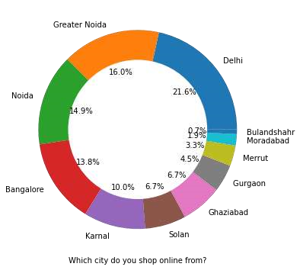
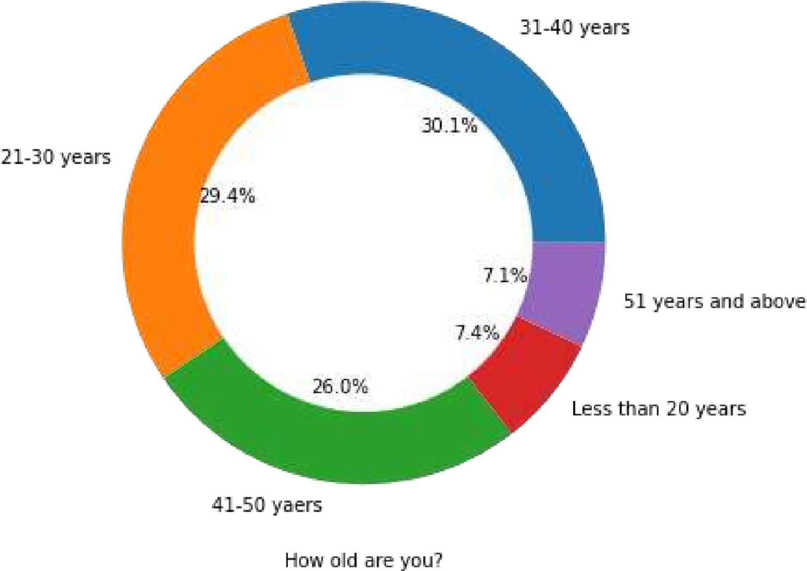
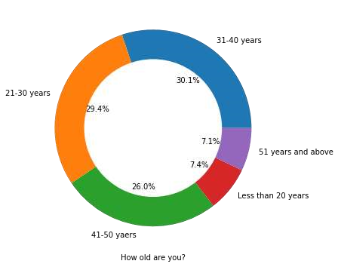
Most of the people shopping online have been shopping from a long time.
Majority of people shop online 10 times a year, ambiguity can also be seen for range 42 times and above which needs to be handled

Slide 11
2. Intention of repeat purchase – It means how much a person is intended to purchase the product again through online stores. We use the line plot and violin plot to analyse the different factors of repeat purchase and got the following conclusions:
• Heavy shoppers who shop more than 41 times a year shop from all the online brands, some of the people who shop for 32-40 and less than 10 times a year seem to exclude myntra. People shop from Amazon and flipkart whatever be the case.

Slide 12
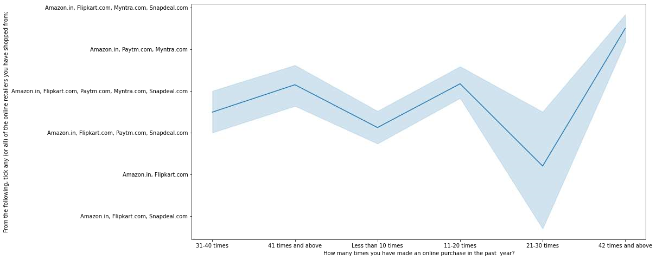

Slide 13
3. Online Retailing – We try to find out which age group shop the most from which city and how they reach to their favourite online store, how long do you think before a purchase decision. We use different plots to conclude on this like lineplot, countplot and obtain the following results:
Highest number of people have been shopping online for above 4 years except for the age group below 20 years and above 50 years. People who are shopping online for 1-2 years does not include teenagers and elder people.
In lines, we can see that density of female customers is more than male. Men living in Banglore and Ghaziabad shop have shopped online for less than 1 year. Highest number of men shopping online belong from Delhi and Noida, while men from Moradabad have been shopping online for the longest. Women from Meerut and Noida have shopped the longest.
Men & Women both spends a lot of time to make a purchase decision on Amazon
Also they spend a less than 1 min before making a purchase decision on Amazon, Flipkart, Paytm
They spend a lot while surfing through many websites.

Slide 14
Even though people who are shopping online for more than 3 years use search engine in large number which indicates that first time users always tried the search engine to shop on their favourite online store for the first time.
Even though people who are shopping online for more than 3 years donot use the application rather use search engine and direct url's in large number which indicates that online brands should update all their platforms rather than just application.

Slide 15
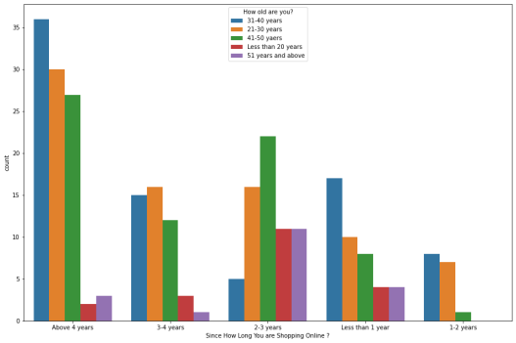
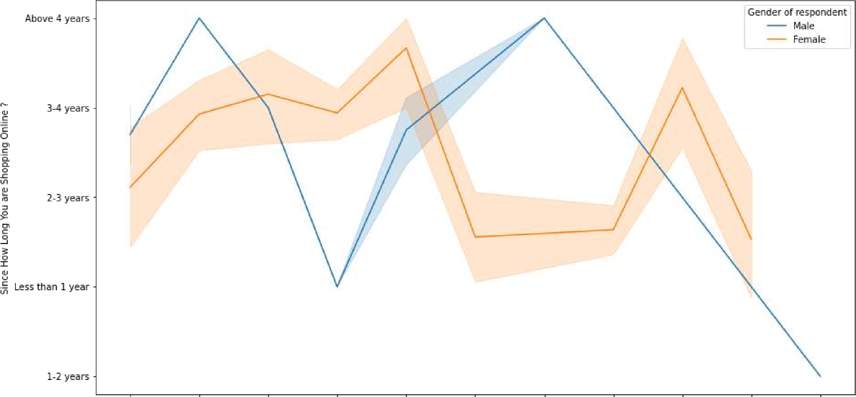

Slide 16
4. Information – Here information means the details regarding a product provide by the different online shopping websites. This play a important role in the business of e-commerce as detailed & correct information makes the buyer more clear about the product. We have used the pie plot to compare how many buyers strongly agree to this point and get to know:
• Above comparisons shows that both men or women strongly agree that online stores must mention a complete and relevant information about the product on their websites. Provision of complete information leaves a clear perception about the product.

Slide 17
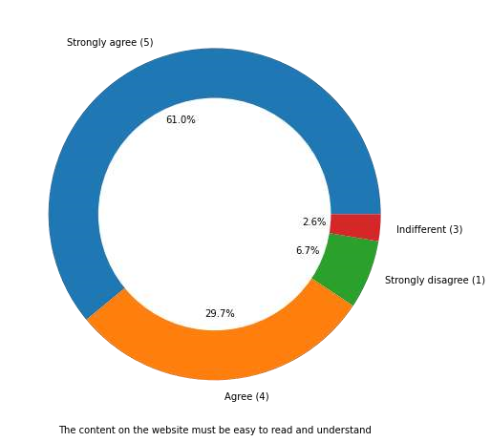
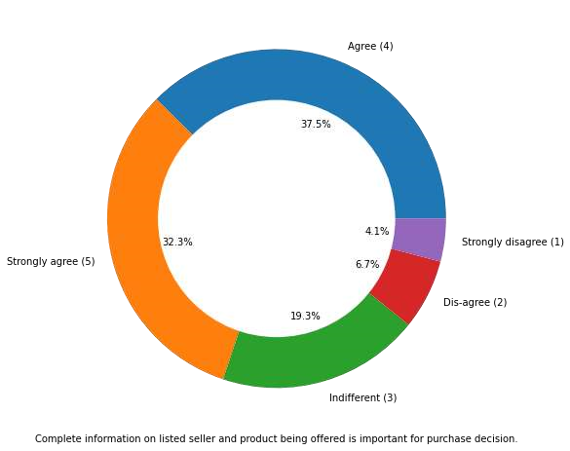
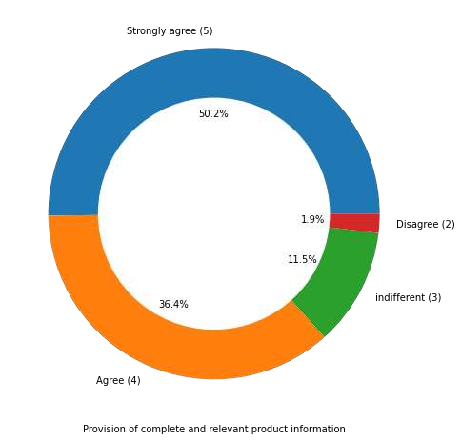

Slide 18
5. System Quality – It refers to the website quality or the user interface qualities of an online shopping website. If the website is slow or not maintain the quality then the ecommerce business can face the loss of customers as well so it plays a significant role in the customers retention. We have used the strip plot to compare the thoughts foe male or female about the system quality of different shopping portals.
There are peoples who are strongly disagree that there is an ease of navigation on the website in any of the online store
Loading & processing speed of any online shopping website can create a difference in the number of customers.
User friendly interface interact the customer
Most of the websites doesn't have the convenient payment method

Slide 19
Most of users trust that the online retail store will fulfill its part of the transaction at the stipulated time
Online websites have a good backend customer care services to their customers
Online websites are able to provide the privacy to their customers
Most of the online stores have a good responsiveness

Slide 20
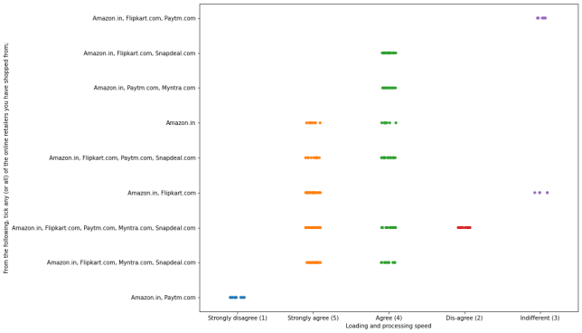
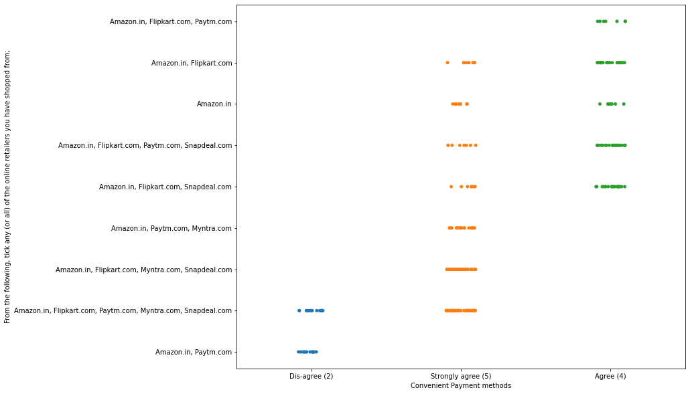

Slide 21
6. Satisfaction – How much a customer is satisfied by the online retailing store and which factors affect the satisfaction. Satisfaction of a customer should be the priority of every online shopping store. We have some factors in the dataset, so we used the pieplot to compare the thoughts of buyers and conclude that these four factors strongly agreed by the buyers:
Displaying quality information
A good website with better system quality
Net Benefits from the online store
Trust on the website by the users

Slide 22
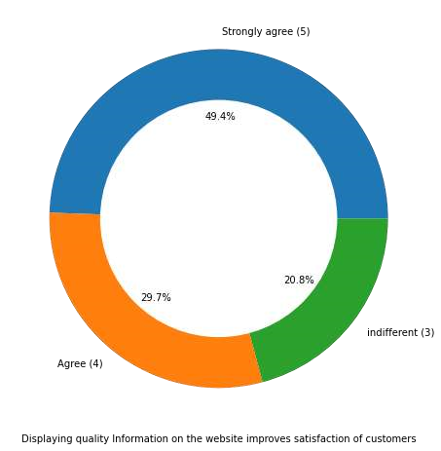
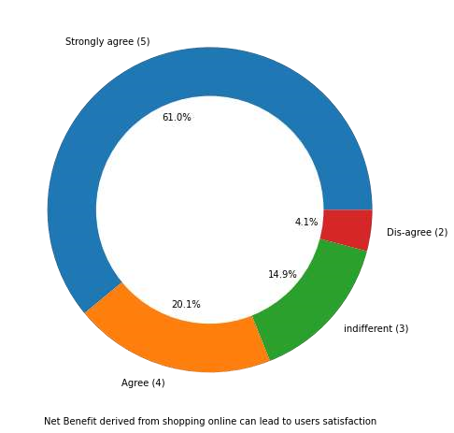
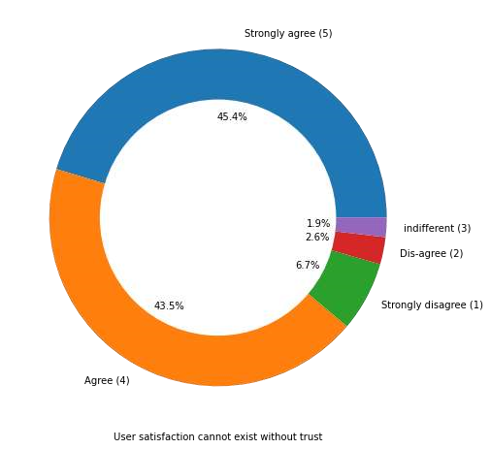

Slide 23
7. Net Benefits - A person buy online for the benefits and looking forward to his net benefits on the purchase. Shopping online provides great benefits to the buyers that’s why they attract towards it. We used countplot to analyse how many people(he/she) agreed that benefits plays a important role.
Below are some benefits a user expects after shopping online:
Online shopping gives monetary benefit and discount
Enjoyment is derived from shopping online
Shopping online is convenient and flexible
Return and replacement policy of the e-tailer is important for purchase decision
Gaining access to loyalty programs is a benefit of shopping online • Monetary savings
with the above comparison we can conclude that Mens participated actively in the survey and there are some of the things peoples are indifferent with others more

Slide 24
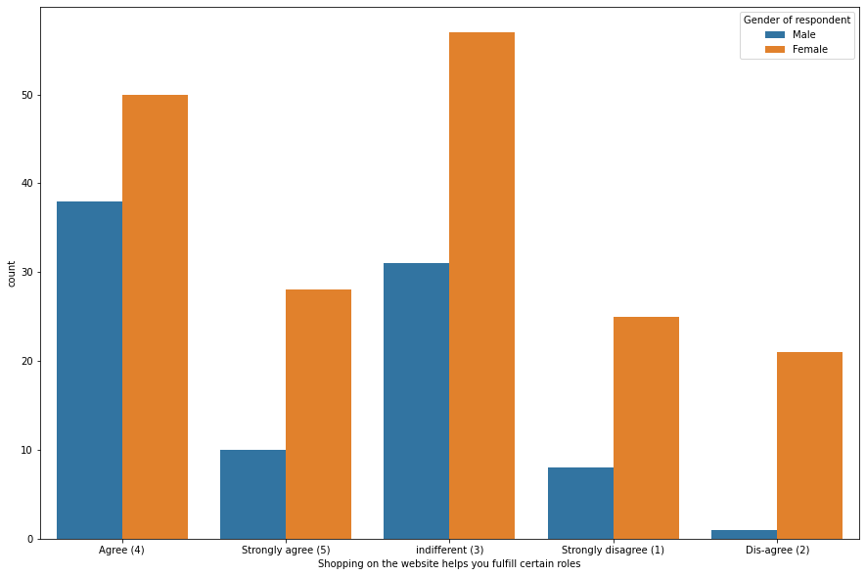
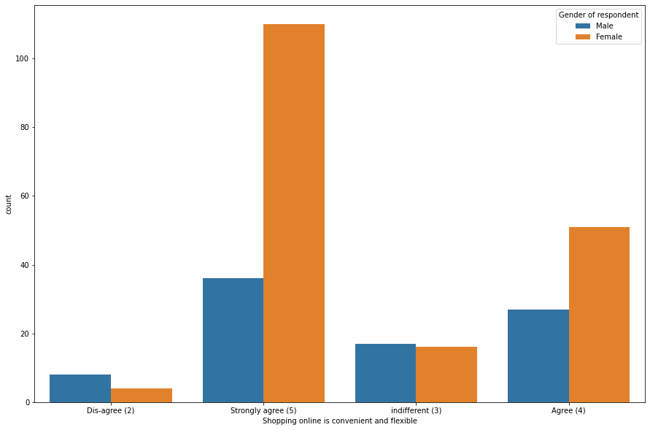

Slide 25
8. Brand Image – A shopping platform becomes a brand when it maintains its standards and able to provide the best quality products, support & services, satisfaction continuously to their customers. By the use of pieplot we try to find out which website performs well in the market and maintain its standards & quality.
Amazon, Flipkart have been had the highest votes for having all the positive points and have maintained a very good brand image followed by paytm and the myntra.
We can clearly see that most of the time people abandon the bag is beacuse they get a better alternative offer or promo code not applicable. There is also lack of trust seen in amazon, flipkart and paytm by some people.

Slide 26
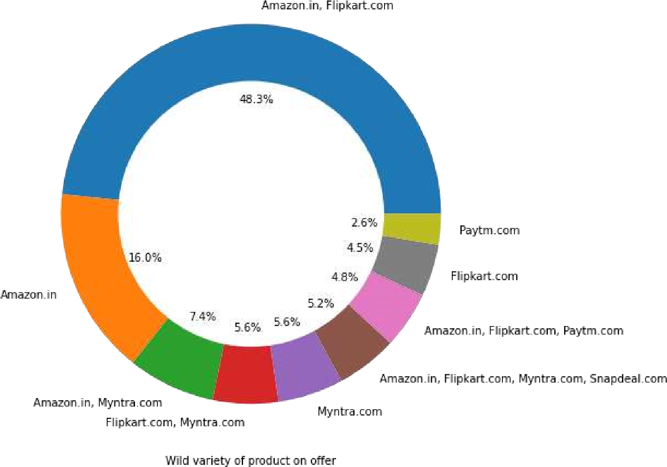
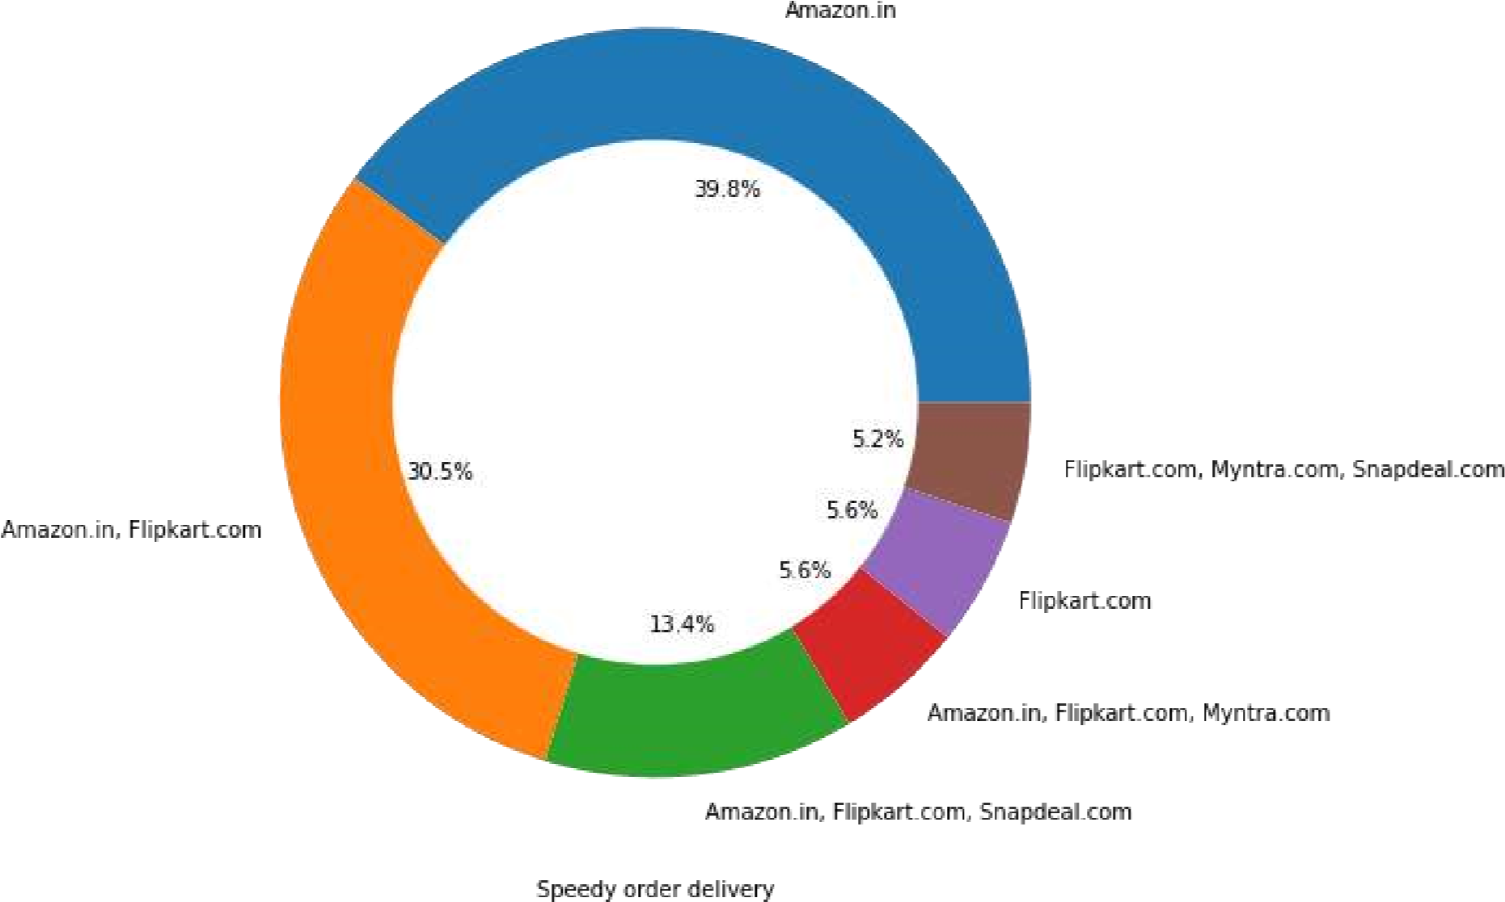
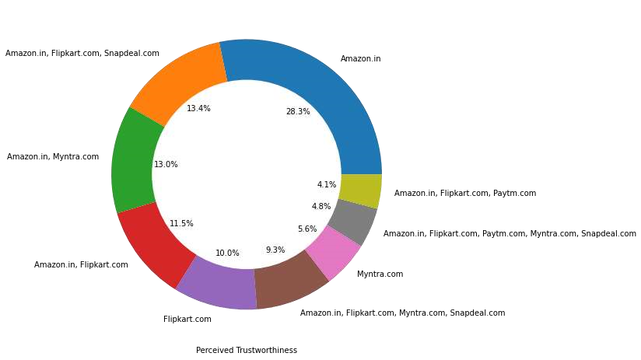

Slide 27
9. Loyalty - Loyalty is what a customer shows towards a website even after facing some issues and continue shopping on that website. Loyalty of a customer is what a E-commerce business earns.
• Customers seem to be more loyal to amazon, flipkart and paytm as even though many of them have given negative remarks about them still they would recommend these platforms to their friend

Slide 28
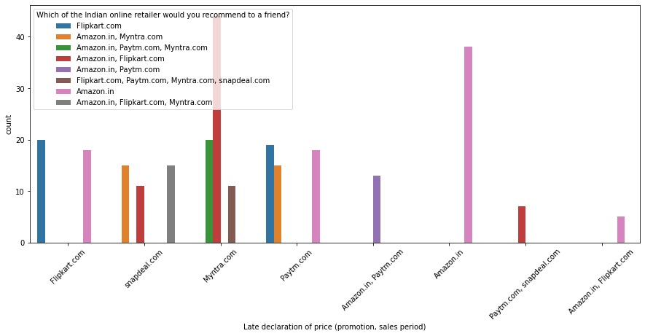
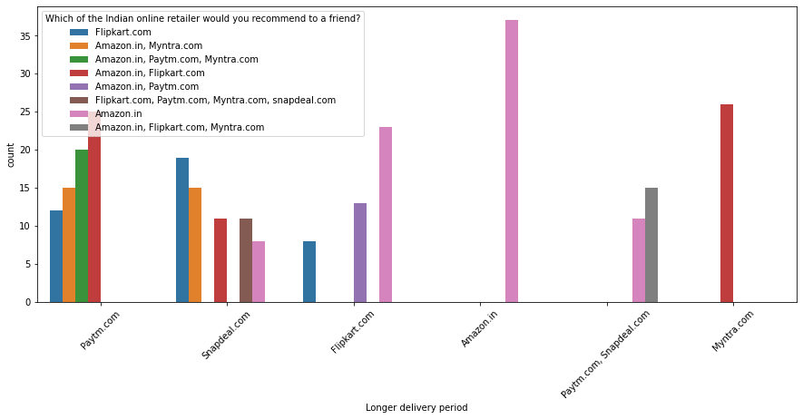

Slide 29
Conclusion
The results of this study suggest following outputs which might be useful for E-commerce websites to extend their business
The cost of the product, the reliability of the E-commerce company and the return policies all play an equally important role in deciding the buying behavior of online customers. The cost is an important factor as it was the basic criteria used by online retailers to attract customers. The reliability of the E-commerce company is also important, as it is even required in offline retail. It is important because customers are paying online, so they need to be sure of security of the online transaction. The return policies are important because in online retail customer does not get to feel the product. Thus, he wants to be sure that it will be possible to return the product if he does not like it in real. Whereas, the logistics factor, which included Cash on delivery option, One day delivery and the quality of packaging plays a secondary role in this process though these are Must-be-quality. This is so because these all does not interfere with the real product and people believe that this is the basic value that E-commerce websites provide.
All the websites were not equally preferred by online customers. Amazon was the most preferred followed by Flipkart. This can be explained easily by previous result that we got. These two companies are most trusted in the industry and hence, have a huge reliability. Also, the sellers listed on these websites are generally from Tier 1 cities as compared to Snapdeal and PayTM which have more sellers from tier 2 and 3 cities. Also, these websites have the most lenient return policies as compared to others and also the time required to process a return is low for these.

